Slide 1



Slide 2
Important Websites
Ours: www.pittsfordrobotics.org
FIRST: www.usfirst.org
Chief Delphi: www.chiefdelphi.com

Slide 3
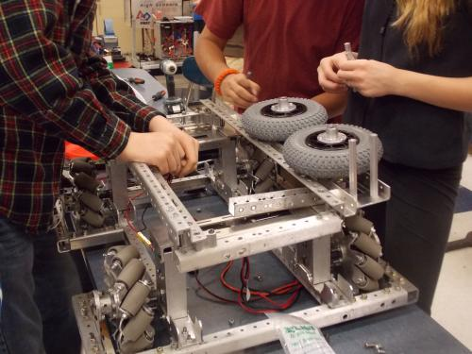
School Club Advisors
Todd Benz - MHS -Technology Education Teacher todd_benz@pittsford.monroe.edu
Brian Holliday – SHS - Technology Education Teacher brian_holliday@pittsford.monroe.edu
Cell 355-5089 Work 267-3155

Slide 4
People
~ 8 Mentors from Community
~30 Students

Slide 5
Agenda
Overview of FIRST
Overview of our Team
Time Schedule
What can Parents Do?
Fundraising
Travel Plans
Food Arrangements

Slide 6
What is FIRST
FIRST stands for “For Inspiration and Recognition of Science and Technology.”
It is a robotics competition which pairs high schools with corporate sponsors to design and build a robot in 6 weeks which will compete in a sport-like event.
Notes:
Students get to:
Learn from professional engineers
Build and compete with a robot of their own design
Learn and use sophisticated software and hardware
Compete and cooperate in alliances and tournaments
Earn a place in the World Championship
Qualify for over $18 million in college scholarships

Slide 7
What is the Game Like?

Slide 8
Last years game
http://www.youtube.com/watch?v=itHNW2OFr4Y

Slide 9
What Does it Mean for Students?
Students get to:
Learn from professional engineers
Build and compete with a robot of their own design
Learn and use sophisticated software and hardware
Compete and cooperate in alliances and tournaments
Earn a place in the World Championship
Qualify for over $18 million in college scholarships

Slide 10
Our Team
Sentry Safe
Monetary Sponsorship
Xerox
Business profssional
Monetary Sponsorship
Pittsford Central School District
Administration Support
Faculty Advisors

Slide 11
Sub Teams
Electrical/Pneumatics
Mechanical/Fabrication
Animation
Programming
Webpage
Strategy/Drive
Business/Marketing
Spirit/Logo
Team Leadership
Photo/Video/Awards

Slide 12
Time Schedule
Sept-Dec: Preseason Training/Subteams
TIMS team Profile Deadline Dec 9th
Kick off - January 4th 2014
Bag & Tag robot – February 18th
?Buckeye Regional 20-Mar - 22-Mar-2014 ?
Finger Lakes Regional 27-Mar - 29-Mar-2014
Goal
FIRST Championship 24-Apr - 26-Apr-2014

Slide 13
What can parents do?
*Food Arrangements
*Fundraising Support
Field Construction
Engineering/Design Support – Mech/Elect etc….
Chaperone
Team Spirit
Exhibition Organization
Volunteer at Competitions
*Donations!
Notes:
Web design – design and maintain web page and calendar
Electrical – help students stay on task /troubleshooting/safety
Programming – help students stay on task possibly know C++
Mechanical – help students stay on task / troubleshooting/safety
CAD – students stay on task
Marketing – help students design T-shirts/Buttons/ Brochures etc..
Marketing 2 – Press release/TV coverage of events
Practice field build (mostly woodworking)
Chaperone events – attend events, get seating and lunches
Special Event Awards – Chairman's award, Woody Flowers, Entrepreneurial
Solicit in-kind donations – list of services and materials needed by the team
Community outreach – coordinate events such as Imagine RIT/
Write thank-you note

Slide 14
Fundraising Goals
Team Fundraisers/Individual Fundraisers
1st Regional $5000
2nd Regional $4000
Championship $5000
Part for robot $3000
Total $17,000 **
** denotes no travel expenses included.

Slide 15
Food Arrangements
We are hoping to provide food for the students on Saturdays and Sundays for Lunch and possibly dinner
Total of 19 meals, 6 Saturdays, 2 Sundays (1 Monday, and 1 Tuesday.)

Slide 16
In Kind Donations
We have a wish list of donations that would help the team. If you have any contacts that might be willing to donate any of these, let us know.
Sample List
Food
Paper Plates/Cups
T-Shirts (printing)
Tools
Team Trailer
Machining Services

Slide 17
Questions?

